Slide 1




reslr: An R package for relative sea level modelling
Maeve Upton
8th Annual Irish Sea Level Meeting

Slide 2
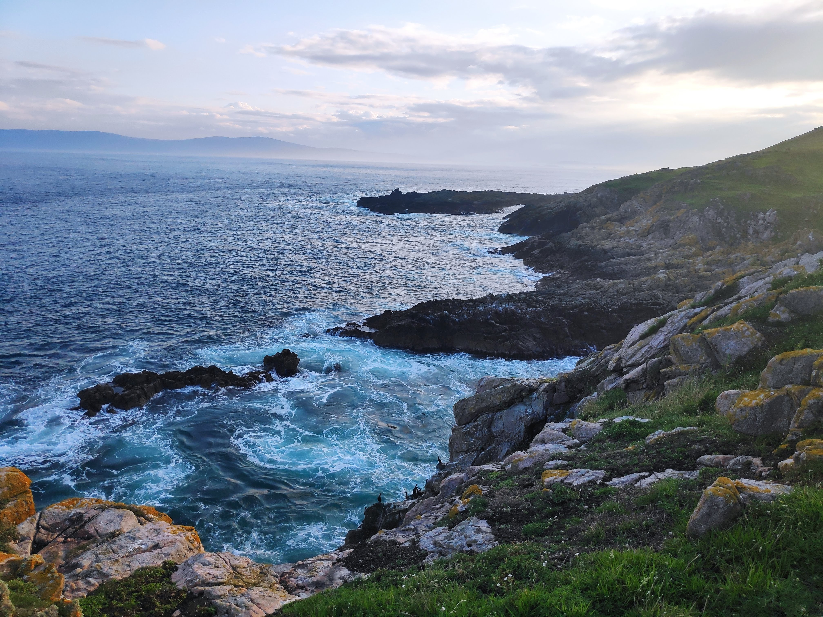
What is Relative Sea Level?

Slide 3
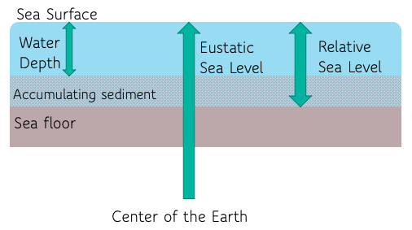
Relative sea level (RSL) is the difference between sea surface level and the Earth’s sediment surface.
RSL changes are part of a complex pattern of interactions, all with different timescales & vary spatially.

Slide 4
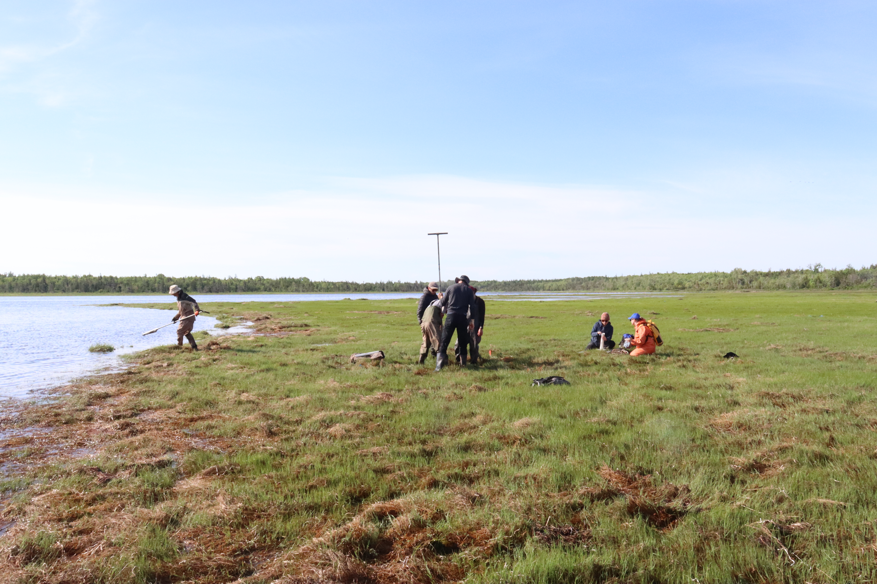
What data do we use?
Piecuch 2022

Slide 5
Satellite
Proxies
Tide Gauges
Jason satellite uses radar to measure height of ocean surface
Short term ( ~ 25 years)
Global Sea Level Observing System monitors tides in ~80 nations
Medium term (~150 years)
Proxy records arise from salt marshes cores & sediments or fossil organisms as indicators for RSL
Long term (~ 500 years)
Notes:
Salt marsh sediment accumulation rates keep up with changes in RSL . A core is taken & fossil organisms can indicate historic SL

Slide 6

The reslr package: An R package for modelling RSL changes

Slide 7

The reslr package[8]
An R package for RSL modelling
Examines proxy records and tide-gauge data
Performs Bayesian modelling of RSL data
Includes a variety of different statistical models
Framework for loading data, fitting models, plotting and summarising the results.
Open source. Available on CRAN (Comprehensive R Archive Network)
More info: https://maeveupton.github.io/reslr/

Slide 8
How to run reslr
Load in data: “reslr_load”
Plotting raw data: “plot”
Run statistical model: “reslr_mcmc”
Check model convergence: “summary”
Plot results: “plot”

Slide 9
Model options in the reslr package
Statistical Model | Model information
Errors in Variables Simple Linear Regression | A straight line of best fit accounting for bivariate uncertainty using EIV uncertainty method
Errors in Variables Change Point model | An extension of linear regression modelling process. It uses piece-wise linear sections & estimate where/when trend changes occurs [9]
Errors in Variables Integrated Gaussian Process | A non-linear fit using a Gaussian process prior on the rate of sea-level change that is then integrated [10]
Noisy Input Spline in time | A non-linear fit using regression temporal splines
Noisy Input Spline in space and time | A non-linear fit for a set of sites using regression spatio-temporal splines
Noisy Input Generalised Additive Model for the decomposition of RSL signal | A non-linear fit for a set of sites across a region & provides a decomposition of the signal into regional, linear local and non-linear local components [7]

Slide 10
What model is best in each situation?
Always start with a plot of the data
Single Site
Linear: EIV Linear regression
Hockey Stick: EIV Change point model
Non-Linear Relationship: Use a temporal model, for example EIV Integrated Gaussian Process or NI spline in time.
Multiple Sites Use a spatio-temporal model (e.g., NI spline in space-time).
Multiple Groups of Sites (Different Drivers) Use NI GAM decomposition to capture regional, linear local, and non-linear local effects.

Slide 11
Bayesian Hierarchical Framework
Model Choice
Uncertainty Method
Our approach for Modelling RSL change

Slide 12
Bayesian Hierarchical Framework
Model Choice
Uncertainty Method
Prior information & likelihood to estimate parameters
Our approach for Modelling RSL change
Notes:
Layers borrow strength

Slide 13
Bayesian Hierarchical Framework
Model Choice
Uncertainty Method
Gaussian Process
Generalised Additive Model[4]
Linear Regression
Change Point
Our approach for Modelling RSL change
[5]

Slide 14
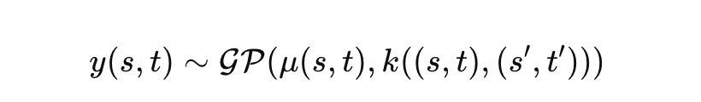
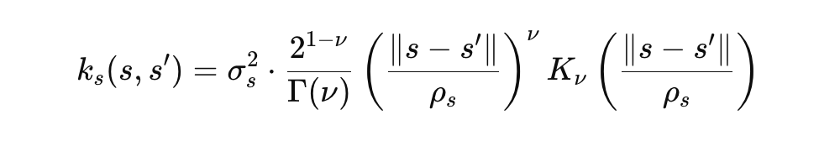
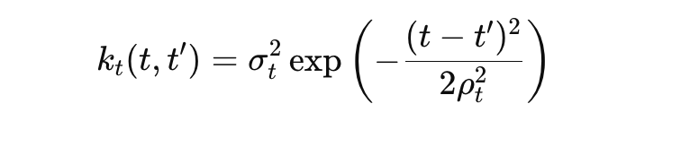



Bayesian Hierarchical Framework
Model Choice
Uncertainty Method
Gaussian Process
Our approach for Modelling RSL change
Spatial variance
Spatial range (controls decay with distance)
Smoothness
Temporal variance
Temporal length scale (controls smoothness)
[5]
Notes:
Temporal variance: How much sea level changes over time at a fixed location
Spatial variance: How much sea level varies across space at a fixed time
Spatial range: Distance over which sea level is spatially correlated or correlation length
Temporal correlation length: Time window over which sea level remains correlated
Process smoothness: Degree of roughness or differentiability in the sea level field

Slide 15
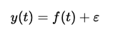
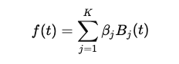

Bayesian Hierarchical Framework
Model Choice
Uncertainty Method
Generalised Additive Model
Our approach for Modelling RSL change
Spline coefficient to be estimated

Slide 16
Bayesian Hierarchical Framework
Model Choice
Uncertainty Method
Noisy Input[5]
Errors-in-Variables[10]
Our approach for Modelling RSL change

Slide 17
Recap: How to run reslr
Load in data: “reslr_load”
Plotting raw data: “plot”
Run statistical model: “reslr_mcmc”
Check model convergence: “summary”
Plot results: “plot”

Slide 18
Case Study 1: Single Site Analysis
Bracky Bridge, Ireland (Kirby et al. 2023) [11]
55 observations
Notes:
Add map here

Slide 19
Step 1: Load in data
ire_reslr <-
reslr_load(data = ire_site)
print(ire_reslr)
#> This is a valid reslr input object with 55 observations and 1 site(s). #> There are 1 proxy site(s) and 0 tide gauge site(s). #> The age units are; Common Era. #> Decadally averaged tide gauge data was not included. It is recommended for the ni_gam_decomp model #> The linear_rate or linear_rate_err was not included. It is required for the ni_gam_decomp model

Slide 20
Step 2: Plot raw data

Slide 21
Step 3: Run statistical model
ire_reslr_output <-
reslr_mcmc(input_data = ire_site, model_type = "ni_spline_t”)
print(ire_reslr_output)
#> This is a valid reslr output object with 55 observations and 1 site(s). #> There are 1 proxy site(s) and 0 tide gauge site(s). #> The age units are; Common Era. #> The model used was the Noisy Input Spline in time model. #> The input data has been run via reslr_mcmc and has produced 3000 iterations over 3 MCMC chains.

Slide 22
Step 4: Model convergence
summary(ire_reslr_output)
#> No convergence issues detected. #> # A tibble: 2 x 7 #> variable mean sd mad q5 q95 rhat #> <chr> <num> <num> <num> <num> <num> <num> #> 1 sigma_beta 1.22 0.428 0.350 0.720 2.01 1.00 #> 2 sigma_y 0.0259 0.0194 0.0193 0.00237 0.0643 1.00

Slide 23
Step 5: Plot model fit results

Slide 24
Step 5: Plot rate of change results

Slide 25
Case Study 2: Multi Site Analysis
Bracky Bridge, Ireland (Kirby et al. 2023) [11], Barlow et al. (2014), Gehrels et al. (2011)
4 sites
167 observations
Notes:
Add map here

Slide 26
Step 1: Load in data
multi_site_reslr <-
reslr_load(data = multi_site)
print(multi_site_reslr)
Adding missing grouping variables: `Site`
This is a valid reslr input object with 167 observations and 4 site(s).
There are 4 proxy site(s) and 0 tide gauge site(s).
The age units are; Common Era.
Decadally averaged tide gauge data was not included. It is recommended for the ni_gam_decomp model
The linear_rate or linear_rate_err was not included. It is required for the ni_gam_decomp model

Slide 27
Step 2: Plot raw data

Slide 28
Step 3: Run statistical model
multi_reslr_output <- reslr_mcmc(multi_site_reslr,
model_type = "ni_spline_st")
print(multi_reslr_output)
This is a valid reslr output object with 167 observations and 4 site(s).
There are 4 proxy site(s) and 0 tide gauge site(s).
The age units are; Common Era.
The model used was the Noisy Input Spline in space time model.
The input data has been run via reslr_mcmc and has produced 3000 iterations over 3 MCMC chains.

Slide 29
Step 4: Model convergence
summary(multi_reslr_output)
No convergence issues detected.
# A tibble: 2 × 7
variable mean sd mad q5 q95 rhat
<chr> <dbl> <dbl> <dbl> <dbl> <dbl> <dbl>
1 sigma_beta 2.02 0.409 0.392 1.45 2.78 1.00
2 sigma_y 0.0198 0.0155 0.0144 0.00143 0.0509 1.00

Slide 30
Step 5: Plot model fit results

Slide 31
Step 5: Plot rate of change results

Slide 32
Case Study 3: NIGAM Analysis
Sources: Kirby et al. 2023, Barlow et al. (2014), Gehrels et al. (2011), Gehrels et al. (2006a), Saher et al. (2015), Long et al. (2014), Kirby et al. (2023)
6 proxy sites & 5 tide gauges
Linear rates generated
Notes:
Add map here

Slide 33
Step 1: Load in data
nigam_site_reslr <-
reslr_load(data = nigam_site,
include_tide_gauge = TRUE,
TG_minimum_dist_proxy = TRUE,
include_linear_rate = TRUE)
print(nigam_site_reslr)
This is a valid reslr input object with 301 observations and 11 site(s).
There are 6 proxy site(s) and 5 tide gauge site(s).
The age units are; Common Era.
Decadally averaged tide gauge data included by the package.
The linear_rate and linear_rate_err has been included.

Slide 34
Step 2: Plot raw data

Slide 35
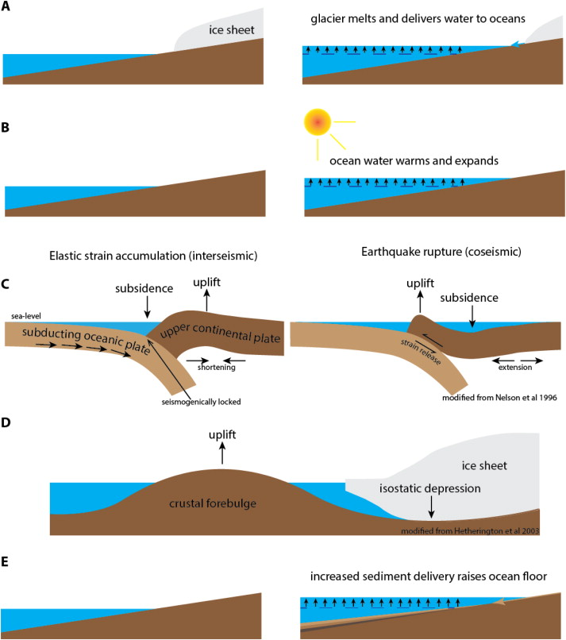
$$r\left(t\right)$$
$$g\left(z_{x}\right)$$
$$l\left(x,t\right)$$
Linear Local Component
Glacial Isostatic Adjustment (GIA)
Relative Sea Level
Melting Ice Sheets
Warming Oceans
Local Factors
Regional Component
Non-Linear Local Component
[4]
Notes:
GIA: when there is a glacier on top of a plate it causes a load/ depression however further away will be an uplift to compensate. When glacier melts this plate rebounds & RSL will appear to fall. Very important along east coast as there was the Laurentide ice sheet and it melted in the last 10000 years but we are still seeing the plate rebounding today.

Slide 36
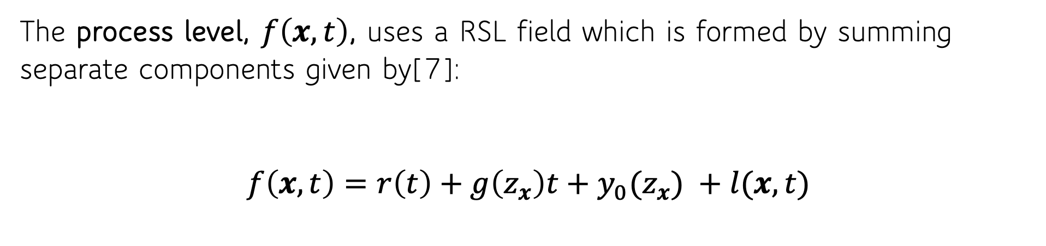
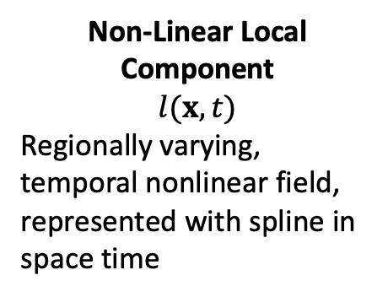
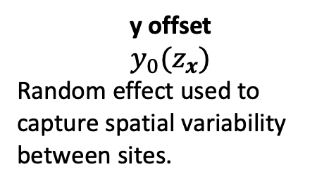
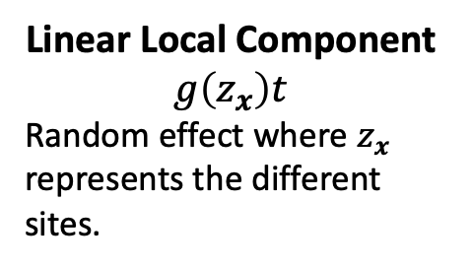
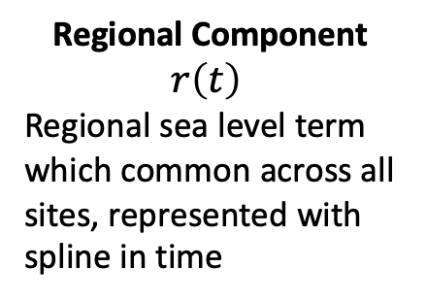
New GAM Approach to RSL Modelling(NI-GAM)
The process level, $f\left(x,t\right)$, uses a RSL field which is formed by summing separate components given by[7]:
$$f\left(x,t\right)=r\left(t\right)+g\left(z_{x}\right)t+y_{0}(z_{x}) +l(x,t)$$
Regional Component
$$r\left(t\right)$$
Regional sea level term which common across all sites, represented with spline in time
Linear Local Component
$g\left(z_{x}\right)t$
Random effect where $z_{x}$ represents the different sites.
y offset
$$y_{0}(z_{x})$$
Random effect used to capture spatial variability between sites.
Non-Linear Local Component
$$l(x,t)$$
Regionally varying, temporal nonlinear field, represented with spline in space time
Notes:
- Developed a new GAM approach to modeling that uses a RSL field by summing up separate components which is similar to other models by Kopp in the past.
- GIA component is a random effect where k is represented of the different sites. It is an independent random variable centred on ICE5G value. The ICE5g is a physical model created by Peltier which gives estimates for GIA rates for different sites around the world. Our Bayesian format is allowing an informed prior to be placed on this component.

Slide 37
Step 3: Run statistical model
nigam_reslr_output <- reslr_mcmc(nigam_site_reslr,
model_type = "ni_gam_decomp")
print(nigam_reslr_output)
This is a valid reslr output object with 301 observations and 11 site(s).
There are 6 proxy site(s) and 5 tide gauge site(s).
The age units are; Common Era.
The model used was the Noisy Input Generalised Additive Model for decomposition of the RSL signal.
The input data has been run via reslr_mcmc and has produced 3000 iterations over 3 MCMC chains.

Slide 38
Step 4: Model convergence
summary(nigam_reslr_output)
No convergence issues detected.
# A tibble: 4 × 7
variable mean sd mad q5 q95 rhat
<chr> <dbl> <dbl> <dbl> <dbl> <dbl> <dbl>
1 sigma_beta_h 2.21 0.534 0.502 1.49 3.17 1.00
2 sigma_beta_r 0.101 0.0379 0.0331 0.0431 0.169 1.00
3 sigma_beta_l 0.122 0.0816 0.0670 0.0218 0.295 1.00
4 sigma_y 0.0106 0.00798 0.00758 0.000878 0.0263 1.00

Slide 39
Step 5: Plot model fit results

Slide 40
Step 5: Plot rate of change results

Slide 41

Other Software
PaleoSTeHM - A modern, scalable Spatio-Temporal Hierarchical Modeling framework for paleo-environmental data
API based upon pyro, a universal probabilistic programming language supported by PyTorch on the backend.
https://github.com/radical-collaboration/PaleoSTeHM/
mgcv package

Slide 42




Artists: Pekka Niittyvirta and Timo Aho
Upton’s work is part of the A4 team (Aigéin, Aeráid, agus athrú Atlantaigh) is funded by the Marine Institute (grant: PBA/CC/18/01).
https://maeveupton.github.io/reslr

Slide 43
References
[2] Shugar, D.H., Walker, et al. (2014) “Post-glacial sea-level change along the Pacific coast of North America.” Quaternary Science Reviews, 97,170-192
[3] Data: Kemp et al. (2018), Kemp et al. (2013), Cahill et al. (2016), Kemp et al. (2014), Kemp et al. (2017), Khan et al (2015), Khan et al(2014), Donnelly et al. (2004b), Nydick et al. (1995), van de Plassche (1991); Compiled in Englehart and Horton (2012), van de Plassche et al. (1998); Compiled in Englehart and Horton (2012), Donnelly (2006), Kemp et al. (2011), Barnett et al. (2017), Gerlach et al. (2017), Barnett et al. (2019), Gehrels et al (2020), Walker et al (2021), Kemp et al. (2015) and Stearns et al (2017)
[4] Wood, Simon (2017), “Generalized Additive Models, An Introduction with R”, CRC Press, 4-7,
[5] McHutchon, A., Rasmussen, C. E. (2011) “Gaussian Process Training with Input Noise”, ﻿Advances in Neural Information Processing Systems
[6] Kopp, R. E., Kemp, A. C., Bittermann, K., Horton, B. P., Donnelly, J. P., Gehrels, W. R., Hay, C. C., Mitrovica, J. X., Morrow, E. D, Rahmstorf, S. (2016) “Temperature-driven global sea-level variability in the Common Era”, PNAS, vol. 113, no. 38
[7] Upton, M., Parnell, A.C., Kemp, A., Ashe, E., McCarthy, G. and Cahill, N. (2023) “A noisy input generalised additive model for relative sea level change along the Atlantic coast of North America”, Arxiv.
[8] Upton, M., Parnell, A.C. and Cahill, N. (2023) “reslr: An R package for relative sea level modelling”, Arxiv
[9] Cahill, N., Rahmsoft, S. and Parnell A.C. (2015) “Change points of global temperature”. Environmental Research Letters
[10] Cahill, N., Kemp, A. C., Horton, B.P. and Parnell, A.C. (2015) “Modeling sea-level change using errors-in-variables integrated Gaussian processes”. Ann. Appl. Stat. 9 (2) 547 - 571
[11] Kirby, J. R, Garnett, E. and Gehrels, W.R. (2023) “Holocene relative sea-level changes in northwest Ireland: An empirical test for glacial isostatic adjustment models”. The Holocene

